Slide 1


Unit 3
Data collection process: Before arrival at the facility
Notes:
Welcome to Unit 3 of Module 4.

Slide 2
By the end of this unit, you will be able to:
describe the CSPro data collection tasks before arrival at the facility
explain who is responsible for each task in the process
Notes:
By the end of this unit, you will be able to:
describe the CSPro data collection tasks before arrival at the facility;
explain who is responsible for each task in the process.

Slide 3
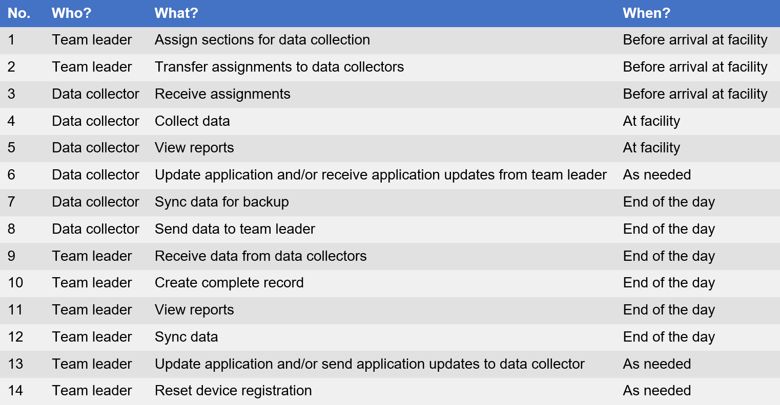
Process of data collection
Notes:
There are a number of tasks that must be carried out during data collection.
In this unit, we will look at the tasks that need to be carried out before arrival at the health facility:
assign sections for data collection;
transfer assignments to data collectors; and
receive assignments.

Slide 4
1. Assign sections for data collection
Notes:
Let’s start with the assignment by the team leader of the different questionnaire sections to the data collectors.

Slide 5
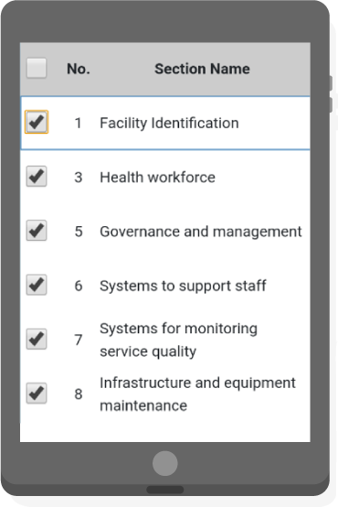
1. Assign sections for data collection
For efficiency, CSPro allows:
different sections of the questionnaire to be assigned to multiple data collectors
flexibility in the order in which sections of the questionnaire are completed
can be long and time-consuming to complete
Notes:
Depending on the modules selected and the level of the health facility visited, the HHFA survey questionnaire can be long and time-consuming to complete.
To enable more efficient data collection, the CSPro tool allows different sections of the questionnaire to be assigned to multiple data collectors who can then collect data simultaneously.
In addition, the CSPro tool allows the data collectors flexibility in the order in which sections of the questionnaire are completed.

Slide 6

1. Assign sections for data collection
Assigns the sections for data collection to the different data collectors in their team
a single team is in charge of collecting data in a health facility
team leaders should share any reassignments before data collection
a questionnaire section can only be assigned to 1 data collector
the team leader is advised against reassigning sections after collection has started
all sections must be assigned to the data collectors before data collection
sections for which data collection has started cannot be reassigned
Notes:
It is the responsibility of the team leader to assign the sections for data collection to the different data collectors in their team. ​
Some parameters must be respected for this process to go smoothly:
a single team is in charge of collecting data in a specific health facility;
a questionnaire section can only be assigned to 1 data collector;
all the different questionnaire sections must first be assigned to the data collectors before data collection can start in a facility;
should the team leader choose to reassign any sections for a facility, they should share the updated assignments with all the data collectors before data collection starts;
once data collection in a facility has started, the team leader is advised against reassigning sections within the facility;
sections for which the data collection has already started cannot be reassigned.

Slide 7
1. Assign sections for data collection
Team leader
Team leaders also need to:
select only the facilities that have been allocated to their team to visit
make sure that the facility selected has the exact name as the facility in their list of facilities
Notes:
In addition, when selecting facilities to assign to the data collection team, team leaders need to be very careful to:
select only the facilities that have been allocated to their team to visit; and
make sure that the facility selected has the exact name as the facility in the list of facilities to visit.

Slide 8
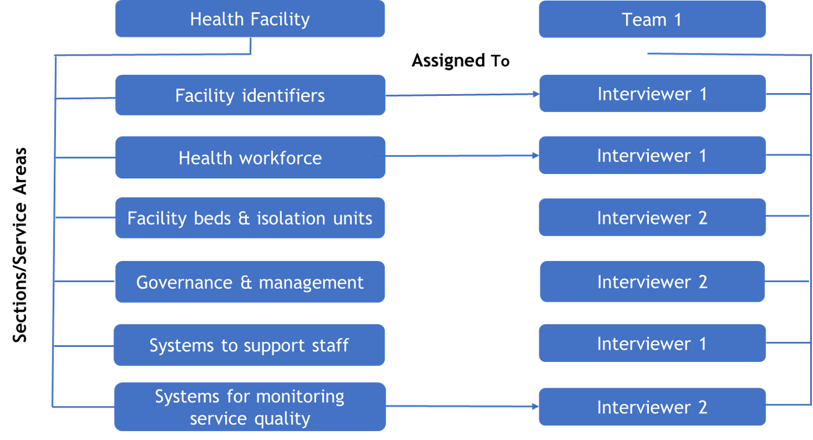
1. Assign sections for data collection
Step 1: Decide how to divide the questionnaire sections amongst the team members.
Notes:
This involves a number of steps.
First, the team leader needs to decide how to divide the questionnaire sections amongst the team members.

Slide 9
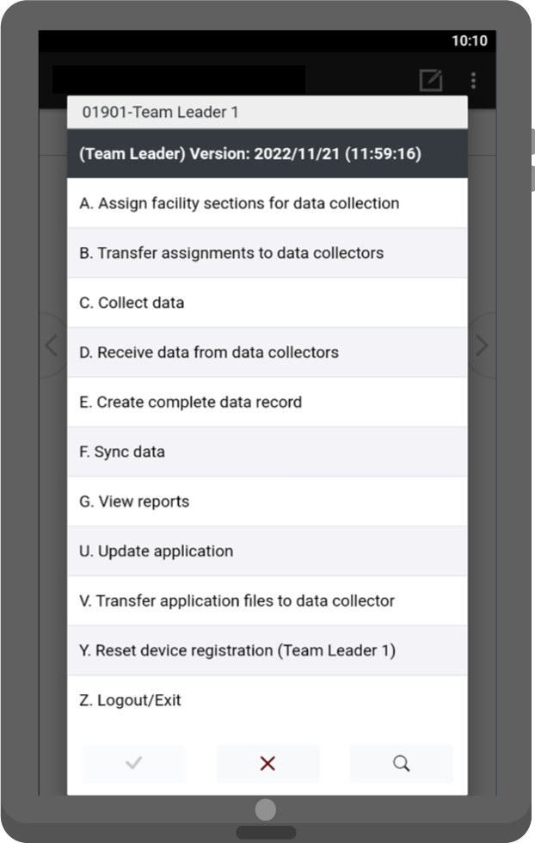
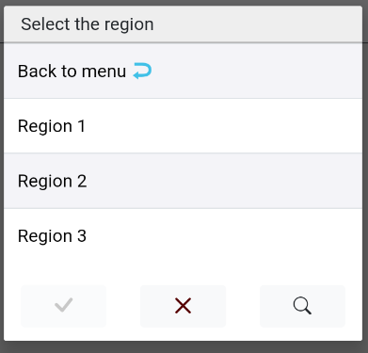
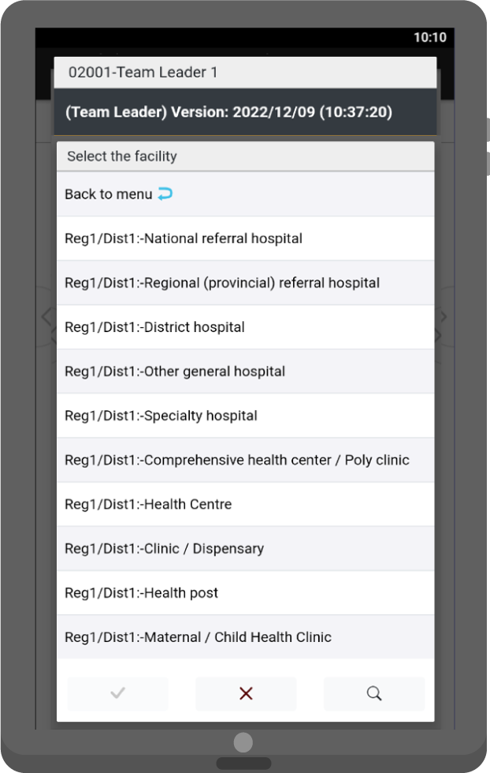
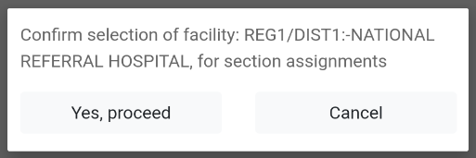
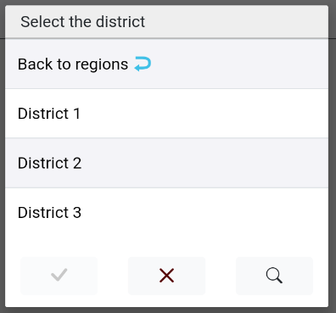
1. Assign sections for data collection
Step 2: Login to CSPro and select the facility they want to make assignments for.
Notes:
Second, the team leader needs to log into CSPro and select the facility they want to make assignments for.
The team leader will need to select the:
region;
district;
and then the facility.
Upon selection of a facility, they are prompted to confirm the selection.

Slide 10
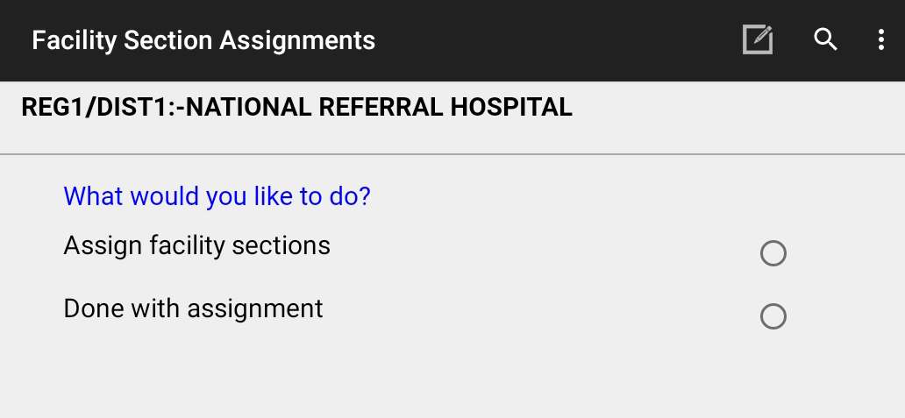
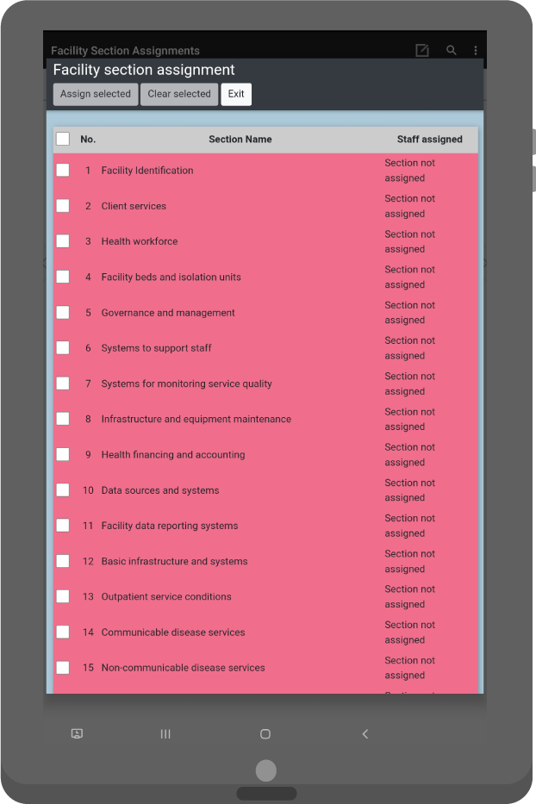
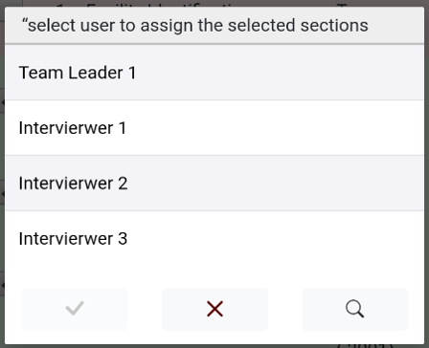
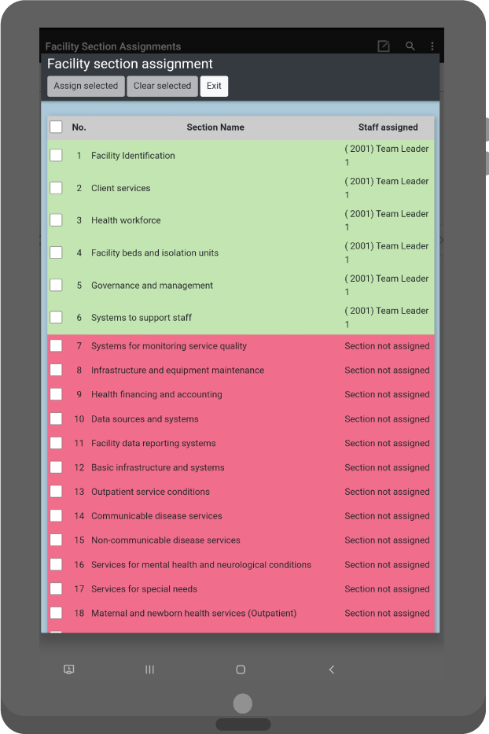
1. Assign sections for data collection
Step 3: Assign sections.
Notes:
Third, the team leader assigns sections of the facility to data collectors on their team:
once the facility has been opened for section assignments, the team leader will be presented with various screens where they can assign sections to the data collectors;
the application will loop through all the relevant sections.

Slide 11
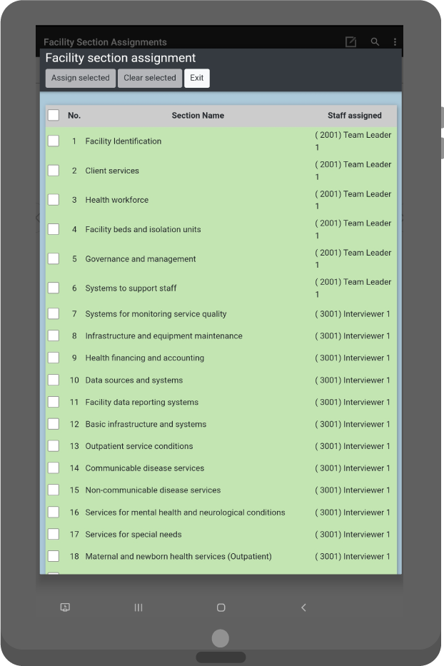
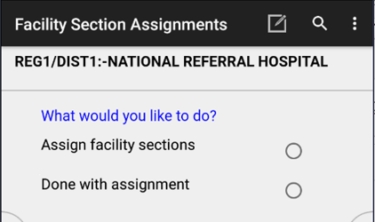
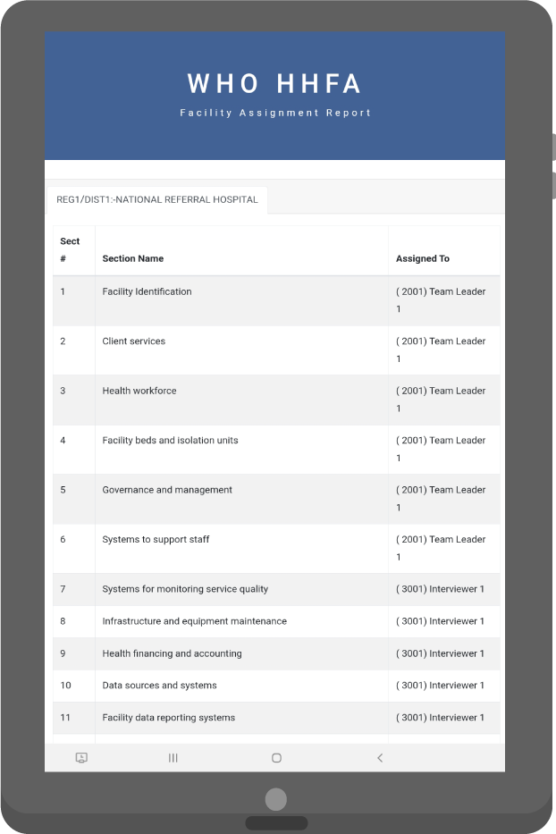
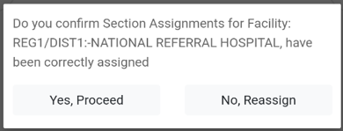
1. Assign sections for data collection
Step 4: Confirm assignments have been done correctly.
Notes:
Upon completion of the assignments, a report is generated showing how the sections have been assigned.
A message will appear to confirm if the sections have been correctly assigned.

Slide 12
TEAM LEADER: 2. Transfer assignments to data collectors
DATA COLLECTOR: 3. Receive assignments
Notes:
Let’s now look at the next two tasks that need to take place before arrival at the facility.

Slide 13

TEAM LEADER: 2. Transfer assignments to data collectors
DATA COLLECTOR: 3. Receive assignments
team leader
data collector
Notes:
Team leaders will need to transfer the assignments to the data collectors so that the data collectors can receive their assignments and start collecting data.
To do this, data between devices needs to be synchronized.

Slide 14

Data synchronization
Area supervisor
Internet
Central Server
Internet
Internet
Bluetooth
Bluetooth
Data collector
Team leader
Data collector
Notes:
There are 2 ways to synchronize data between devices:
through Bluetooth, which consists of peer-to-peer synchronization between devices; or
through the internet, which requires an active internet connection on the device.

Slide 15
TEAM LEADER: 2. Transfer assignments to data collectors using Bluetooth
DATA COLLECTOR: 3. Receive assignments from team leader using Bluetooth
Transferring using Bluetooth does not require an internet connection.
team leader and data collector
must be in close proximity
must perform their actions simultaneously
Notes:
Transferring using Bluetooth does not require an internet connection.
For this, the team leader and data collector:
must be in close proximity; and
must perform their actions simultaneously.

Slide 16
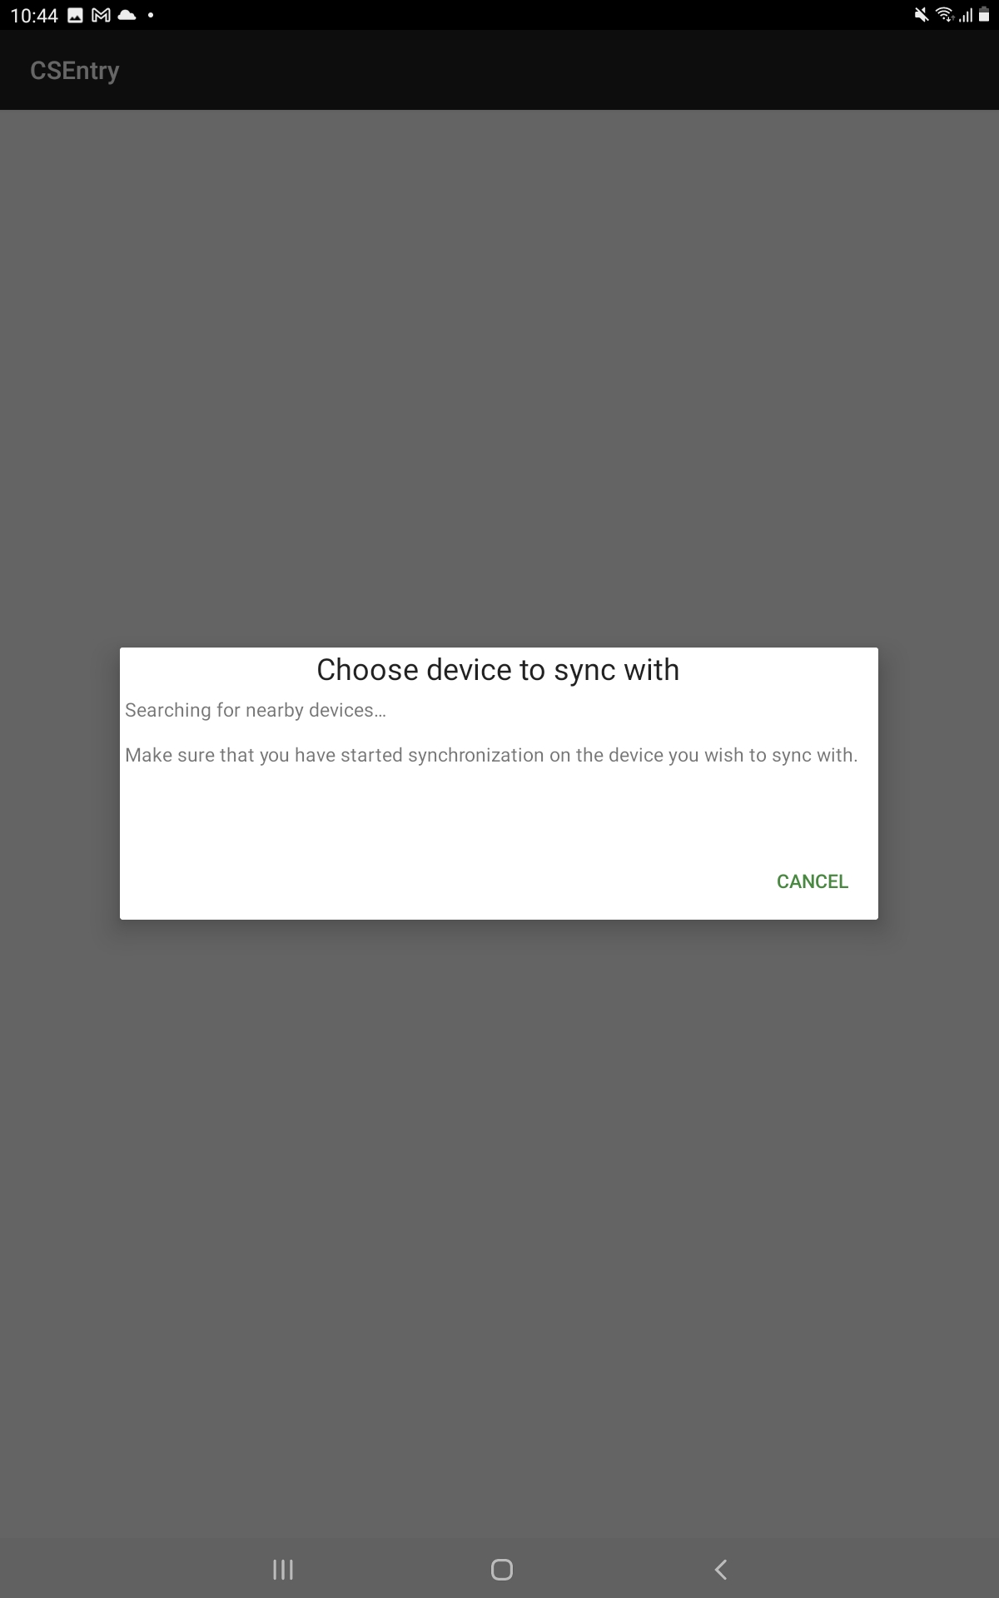

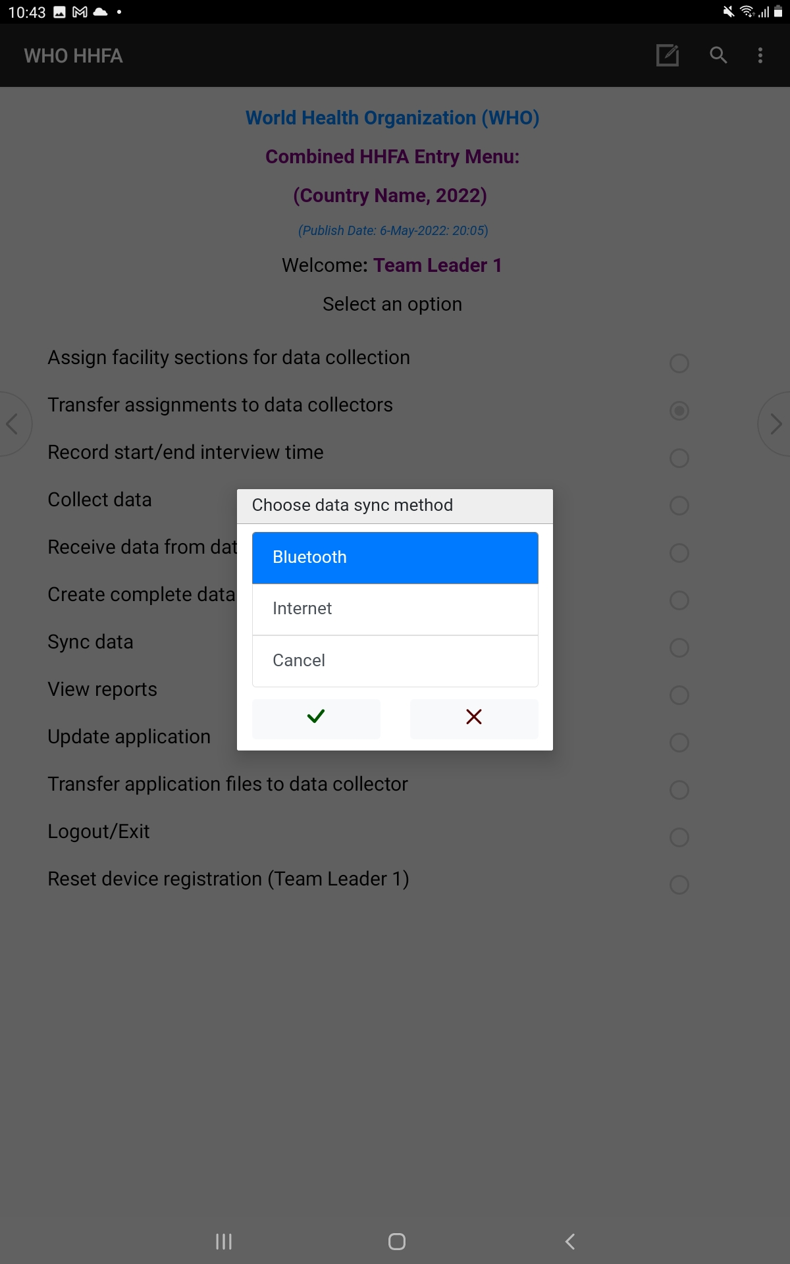


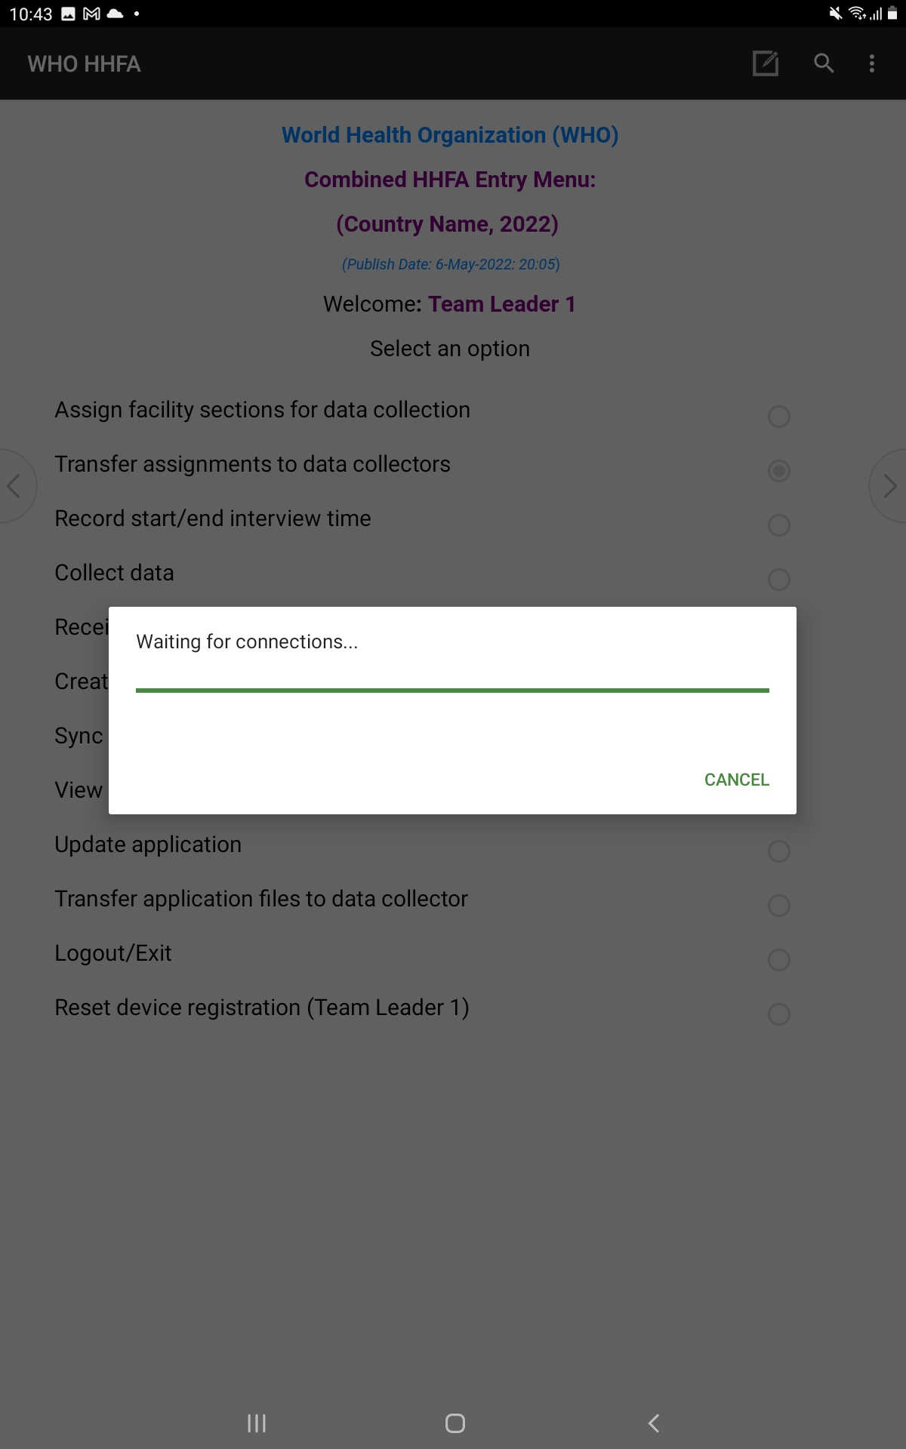
TEAM LEADER: 2. Transfer assignments to data collectors using Bluetooth
DATA COLLECTOR: 3. Receive assignments from team leader using Bluetooth
Data collector sends pairing request to team leader
Team leader
Data collector
Team leader waits for pairing request/accepts
Notes:
To transfer using Bluetooth:
the team leader selects “Transfer assignments to data collectors”;
at the same time, the data collector selects ‘Receive section assignments’;
both the team leader and the data collector select Bluetooth as the sync method;
the data collector chooses the team leader’s device from the list and sends a pairing request, and the team leader waits for the pairing request from the data collector’s device and accepts it when it arrives to enable the devices to pair; ​
once the devices are paired and connected, the assignments will be transferred from the team leader’s device to the data collector’s device.

Slide 17
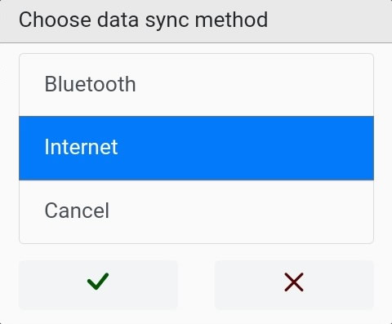

2. Transfer assignments to data collectors using the internet
Team leader
Notes:
To transfer using the internet:
the team leader selects “Transfer assignments to data collectors”;
then selects “Internet” as the sync method;
the application will connect to the internet and the subsequent server;
on successful sync to the cloud, the message “Assignment data synced successfully!” will appear, informing the team leader that the section assignments were uploaded successfully.

Slide 18
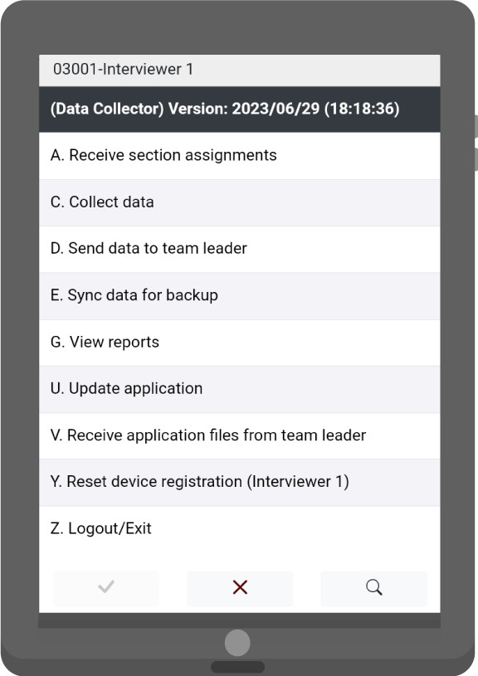
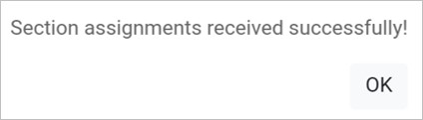
3. Receive assignments from team leader using the internet
Data collector
Notes:
To receive the assignments:
the data collector selects “Receive section assignments”;
next, they select “Internet” as the sync method;
the application will connect to the internet and the subsequent server;
on successful sync from the cloud, the message “Section assignments received successfully!” will appear, informing the data collector that the section assignments were received successfully.

Slide 19
You have now completed Unit 3.
In the next unit, we will look at the data collection process at the facility.
Notes:
You have now completed Unit 3.
In the next unit, we will look at the data collection process at the facility.

